Slide 1
Troubleshooting a MEM managed Windows 10/11
Ronni Pedersen
CoLabora – January 2022

Slide 2





Speaker
Ronni Pedersen
Cloud Architect
Microsoft MVP: Enterprise Mobility (14 years)
MCSE/MCSA/MCITP/MCTS (+75 certifications)
ITIL Foundation Certified
Microsoft Certified Trainer (MCT)
Contact Info
Mail: rop@apento.com
Phone: +45 20 85 94 52
Twitter: @ronnipedersen
Notes:
My name is Ronni Pedersen
I’m a Microsoft 365 focused Cloud Architect at APENTO, a Danish based Microsoft Elite Partner.
I’ve been a Microsoft MVP for almost 15 years… Just proves that I’m getting old ☺
So, in case you want to reach out, here are my contact details.

Slide 3
Takeaways
Tools
The Log Files
Configuration Policy Process
Subscription Based Activation
Troubleshooting Policies

Slide 4
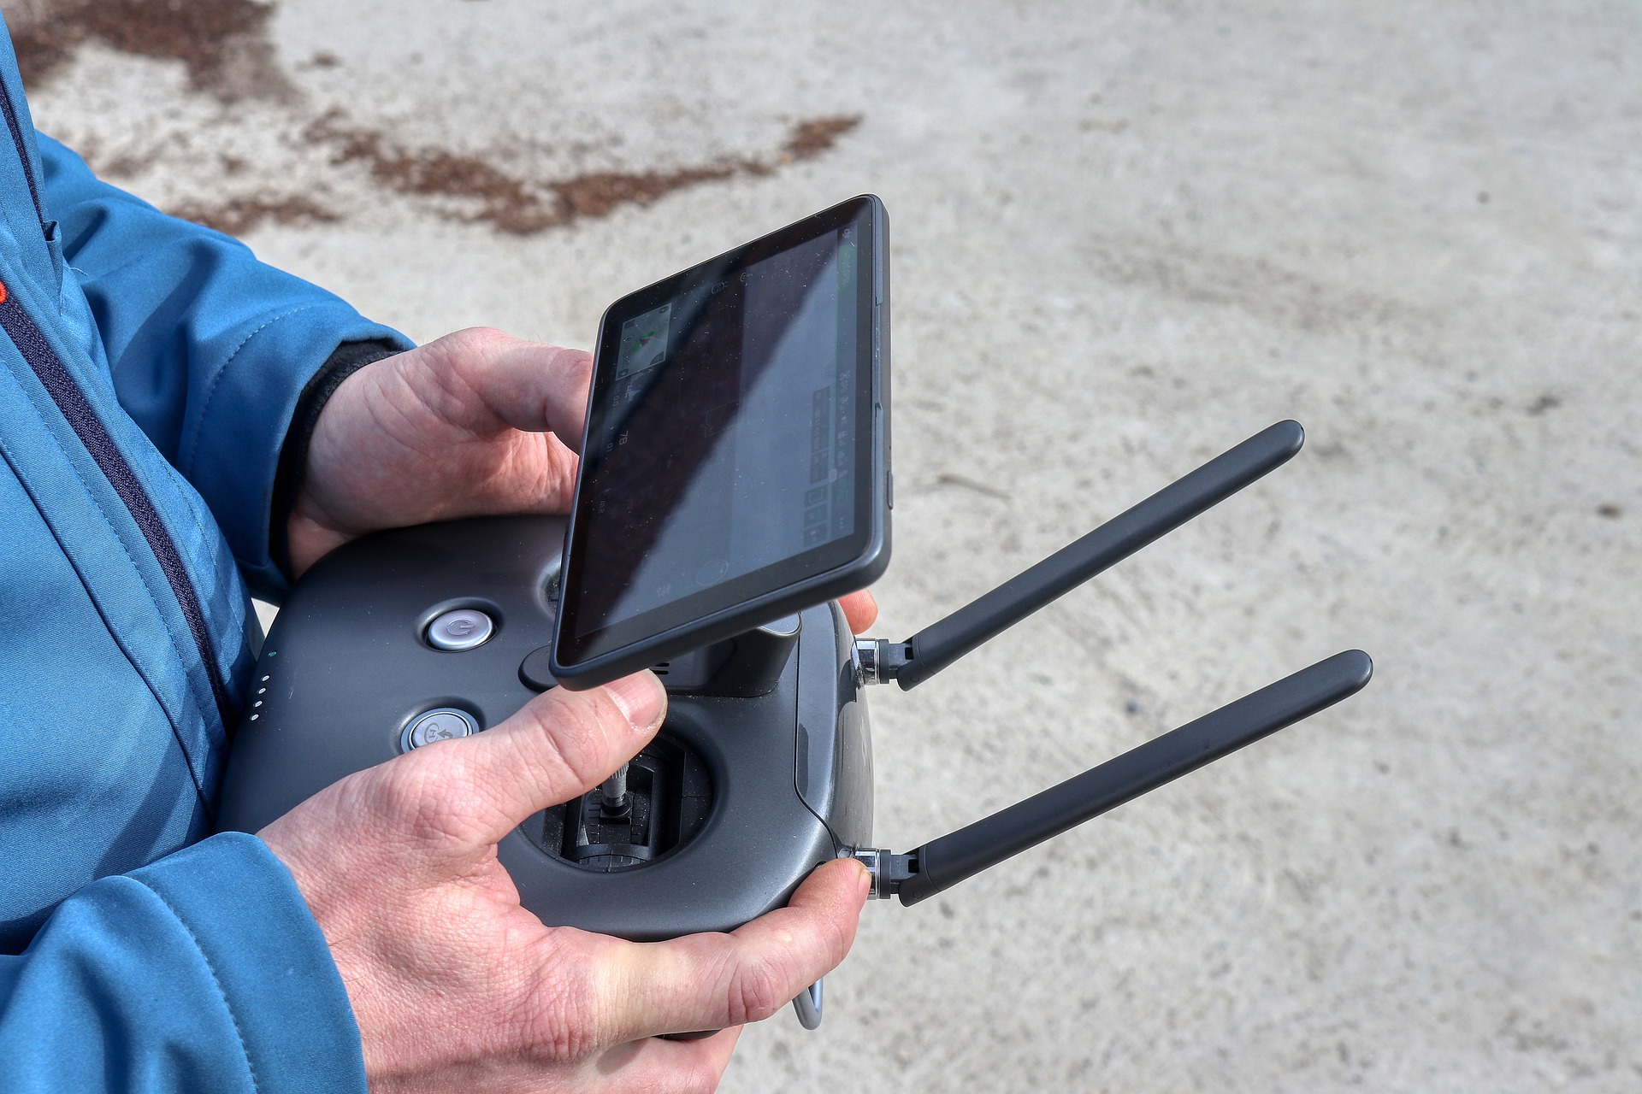
Remote Control
TeamViewer integrates in the Endpoint Management Portal
Quick Assist is built-in
Lacks UAC support
No Logging
Maybe OK for smaller organizations
Can be used during AutoPilot
https://oliverkieselbach.com/2020/03/03/quick-assist-the-built-in-remote-control-in-windows-10/
Notes:
Det mest kedelige er nok Remote Control til “End Users”
Quick Assist: Should be uninstalled ?

Slide 5
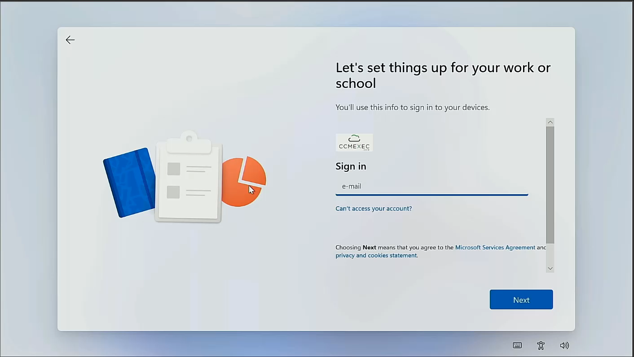
Notes:
Kræver internet access
Security risk ?

Slide 6
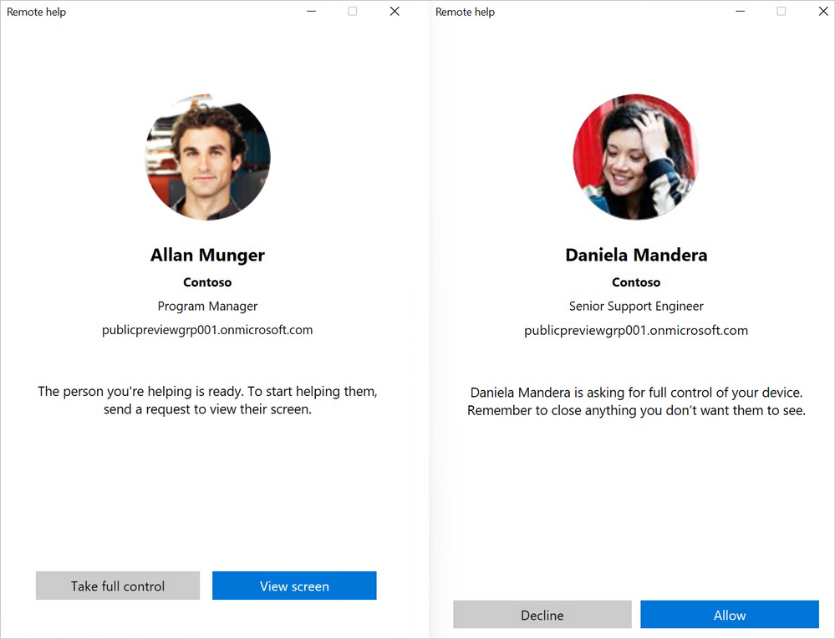
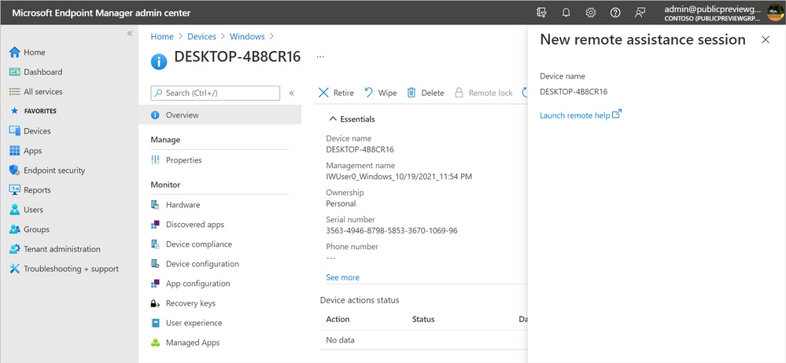
Remote Help (Announced at Ignite)
Support UAC
RBAC
Logging/Tracking
Note: Comes with an additional cost
Notes:
Will be built in to Intune Portal
Nice experince
Logging
Cost ???

Slide 7
CMtrace
Great log reader
Not free, but included in the Intune/MEM license
Deploy it to all clients
https://ccmexec.com/2018/12/copy-and-associate-cmtrace-using-intune-win32app-and-powershell/

Slide 8
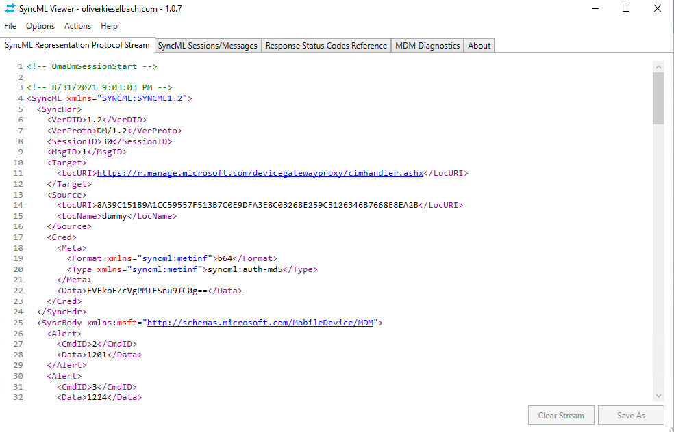
More Tools – advanced troubleshooting
Wireshark
Fiddler
Netmon
SyncMLViewer
SyncMLViewer/SyncMLViewer/dist at master · okieselbach/SyncMLViewer · GitHub

Slide 9
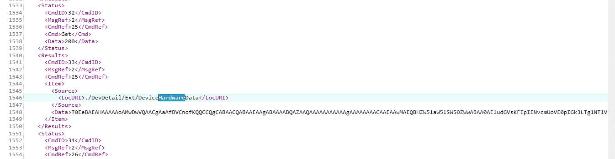

Slide 10
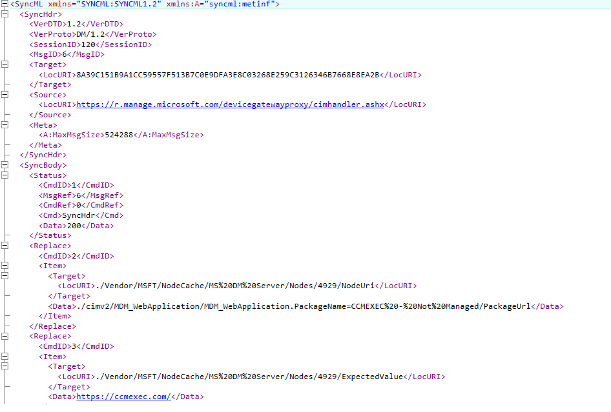

Slide 11
Log Files
Notes:
Speaker: Ronni Pedersen

Slide 12

Collect diagnostics from a Windows Device
Collecting Diagnostic Logs from Windows Devices
All supported versions of Windows 10/11
Both Intune and Co-Managed devices
Corporate-owned devices only
More information:
https://docs.microsoft.com/en-us/mem/intune/remote-actions/collect-diagnostics
Notes:
As a ConfigMgr admin for many years, I always get really happy when I see a good log file ☺
When moving to modern management logging has changed a lot, and people are working remote, so first we need to understand where we can find stuff, and how to get it.
Intune has a built-in feature that allows us to collect the relevant files from a remote device, when we need to troubleshoot a problem.

Slide 13
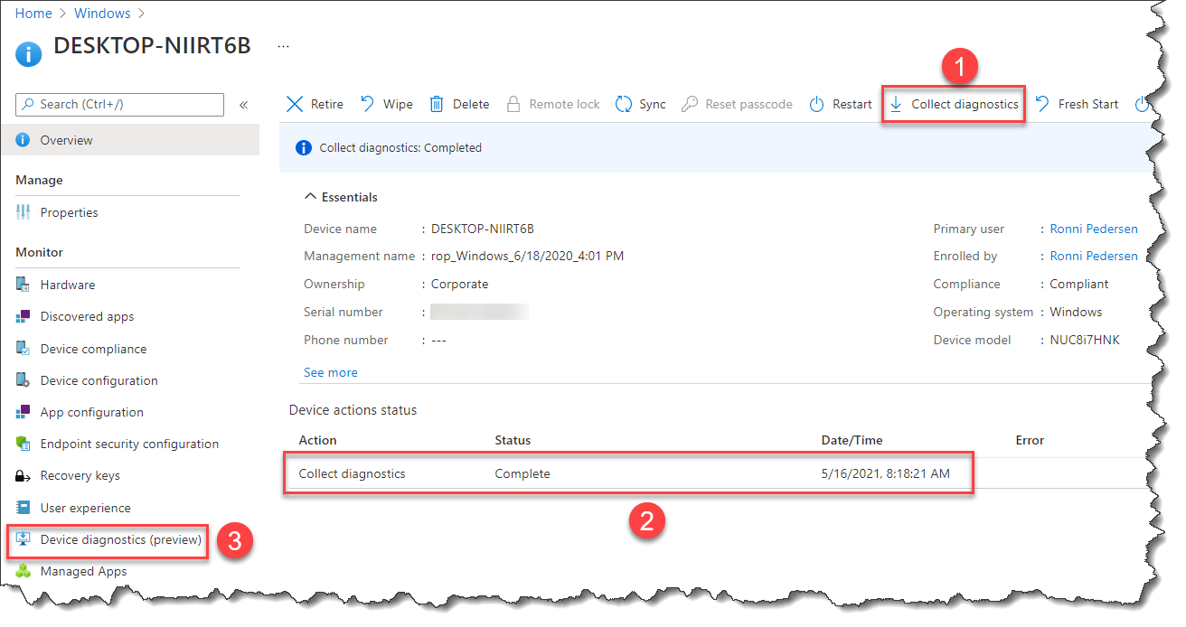
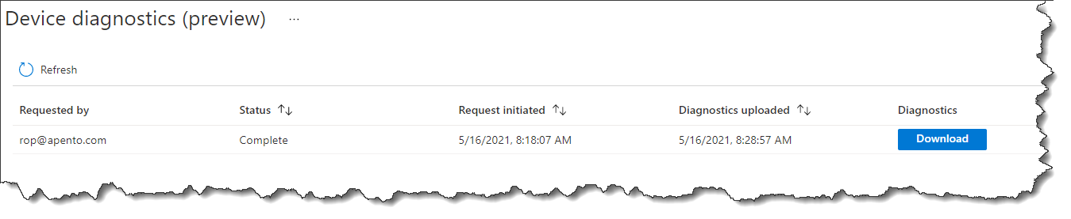
Collecting Diagnostic Logs
Notes:
DEMO:
Endpoint Manager Console / Devices
TPPC-8246 -> Start downloading! (Explain it can take up to 5 mins.)
TPPC-0515 - -> Download collected log
Show website with log references
https://docs.microsoft.com/en-us/mem/intune/remote-actions/collect-diagnostics
PowerShell App Deployment toolkit (Subfolder will not becollected)
<Toolkit_LogPath>$envWinDir\CCM\Logs\Software</Toolkit_LogPath>
Open: (47) FoldersFiles windir_ccm_logs_log
Open: (42) FoldersFiles ProgramData_Microsoft_Windows_WlanReport_wlan-report-latest_html
Intune Only: Use the %ProgramData%\Microsoft\IntuneManagementExtension\Logs*.*

Slide 14
Configuration Policy Process
Notes:
Speaker: Ronni Pedersen

Slide 15
Microsoft 365 Apps Policy
Endpoint Manager Configuration:
Policy 1: Enable Microsoft 365 Apps Automatic Updates
Policy 2: Set the Update Channel
Client-Side debugging:
#1 Check the Intune registry keys
#2 Check the Office registry keys
#3 Force Office automatic updates to run
#4 Force the Office synchronization to update account information

Slide 16
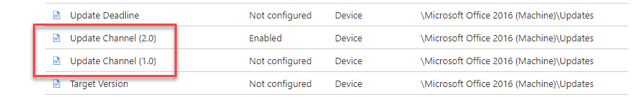
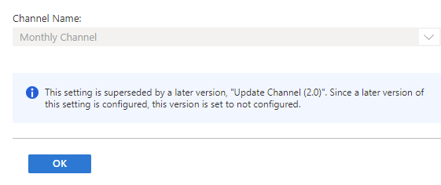
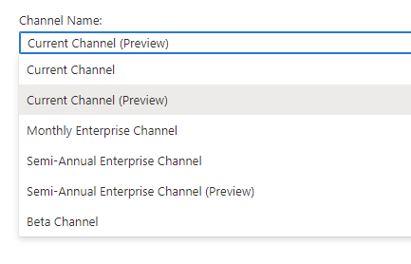
Administrative Templates
Example using Administrative Templates

Slide 17
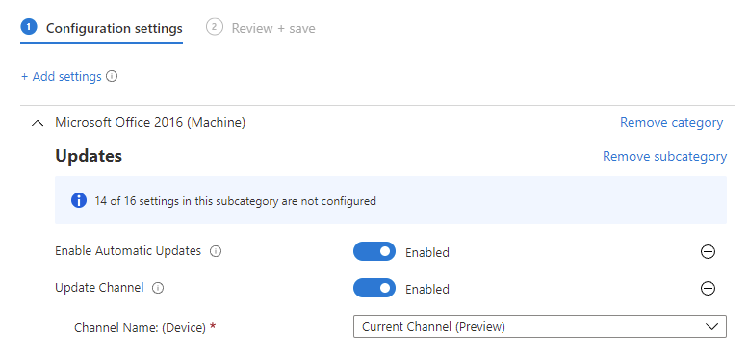
Using Settings Catalog (Preview)
Policy Configuration:
Enable Microsoft 365 Apps Automatic Updates
Set the Update Channel
Notes:
Be sure to assign the policy to your Windows 10 devices. Not Users!

Slide 18
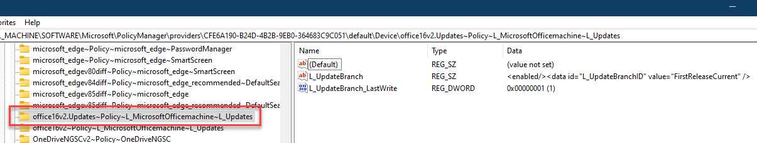
#1 Check the Intune registry keys
Open the Registry Editor, and go to the Intune policy path:
HKLM\SOFTWARE\Microsoft\PolicyManager\Providers\<Provider ID>
\default\Device\office16~Policy~L_MicrosoftOfficemachine~L_Updates
When the policy is applied, you see the following registry keys:
L_UpdateBranch
At this point, the Intune policy is successfully applied to the device.
Notes:
After you assign the policy and the device syncs, you can confirm the policy is applied here.

Slide 19
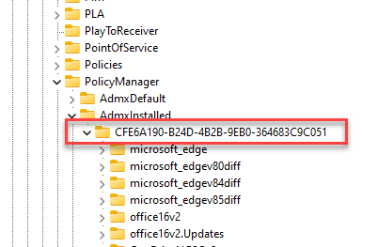
#TIP: Find the Provider ID
Find the provider ID for your device
Open the Registry Editor, and go to:
Computer\HKEY_LOCAL_MACHINE\SOFTWARE\Microsoft\PolicyManager\AdmxInstalled

Slide 20
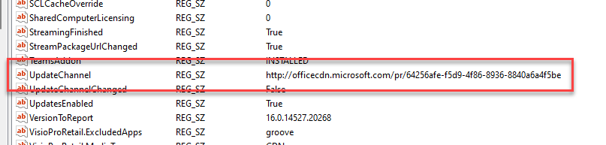
#2 Check the Office registry keys
Go to the Office policy path: Computer\HKEY_LOCAL_MACHINE\SOFTWARE\Microsoft\Office\ClickToRun\Configuration
Check the UpdateChannel value:
Monthly Enterprise Channel = 55336b82-a18d-4dd6-b5f6-9e5095c314a6
Current Channel = 492350f6-3a01-4f97-b9c0-c7c6ddf67d60
Current Channel (Preview) = 64256afe-f5d9-4f86-8936-8840a6a4f5be
Semi-Annual Enterprise Channel = 7ffbc6bf-bc32-4f92-8982-f9dd17fd3114
Semi-Annual Enterprise Channel (Preview) = b8f9b850-328d-4355-9145-c59439a0c4cf
Beta Channel = 5440fd1f-7ecb-4221-8110-145efaa6372f

Slide 21
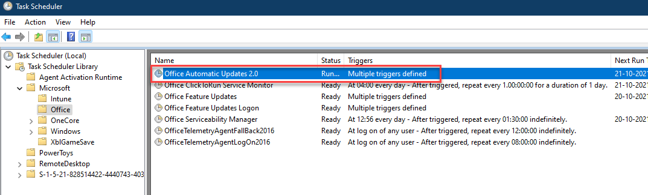
#3 Force Office automatic updates to run
To test the policy, we can force the policy settings on the device
Go to HKLM\SOFTWARE\Microsoft\Office\ClickToRun\Updates
Edit the UpdateDetectionLastRunTime key > delete the value data.
Launch Task Secheduler > Microsoft > Office
Run “Office Automatic Updates 2.0”

Slide 22
Troubleshooting Subscription based activation

Slide 23
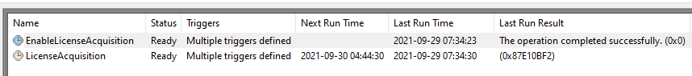
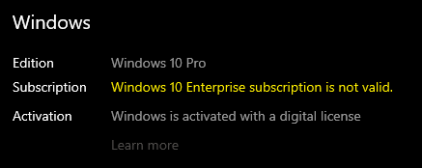
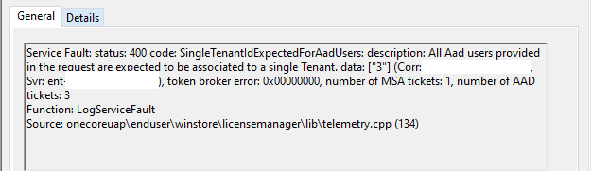
Subscription based activation
Re-activated every 30 days
Two scheduled tasks triggers License Acquisition
The store does the renewal
In this case more than one AzureAD account was added under ”Access work or School”

Slide 24
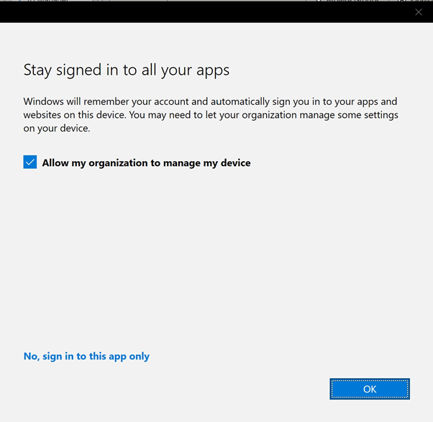
Stay signed in to all your apps = Evil
“Stay signed in to all your apps” dialog in Microsoft Apps (outlook, Powerpoint, excel….)
Recommended to block on Hybrid Join
Needs to be blocked on all modern managed Windows 10!
Personal devices: Intune sync will fail
AzureAD Joined devices: Windows Activation will fail

Slide 25
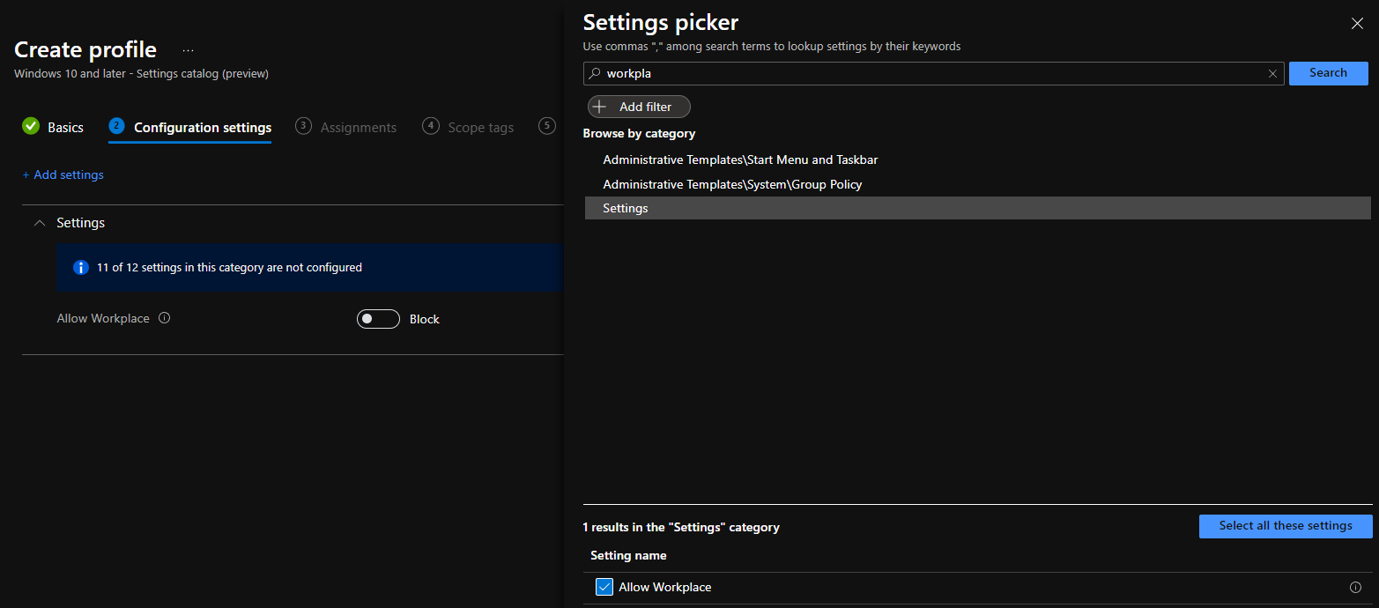
Blocking Workplace join

Slide 26
Troubleshoot enrollment
Notes:
jorgen

Slide 27
Troubleshooting Windows enrollemnt in Intune
Valid License assigned to the user?
Is the user allowed to enroll a device?
Network issues, proxy etc.?
Enrollment restrictions that blocks enrollment?
Number of devices already enrolled (Device Limit)
MDM Terms of use not correct

Slide 28
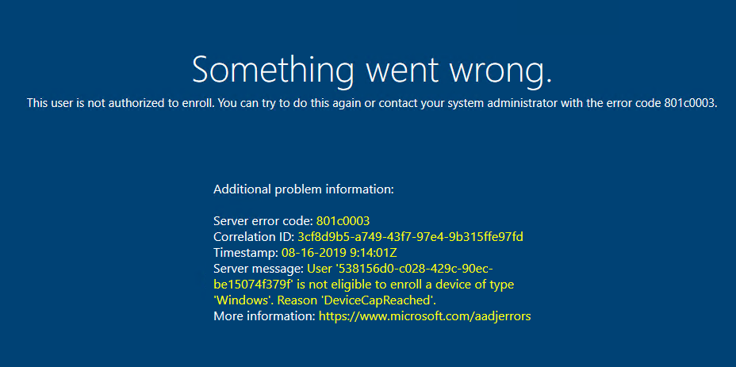
DeviceCapReached = Device Limits

Slide 29
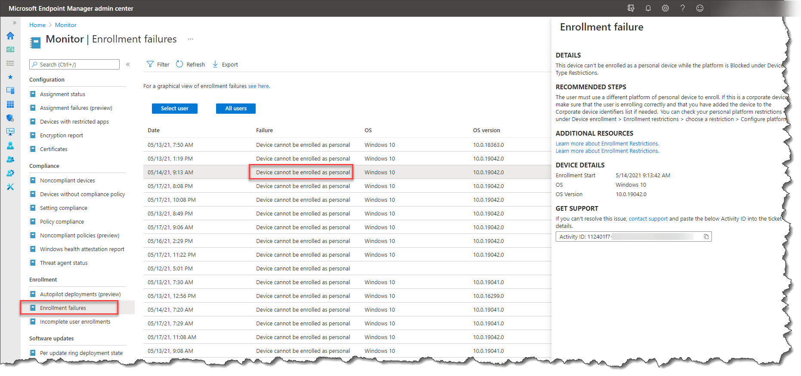
Enrollment Failures

Slide 30
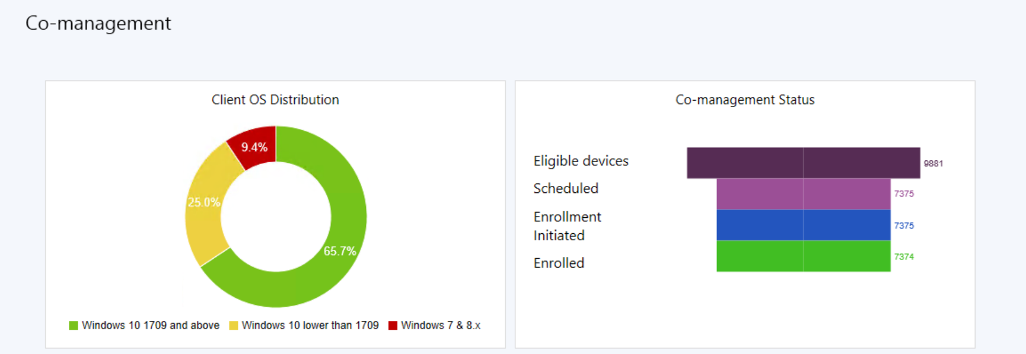
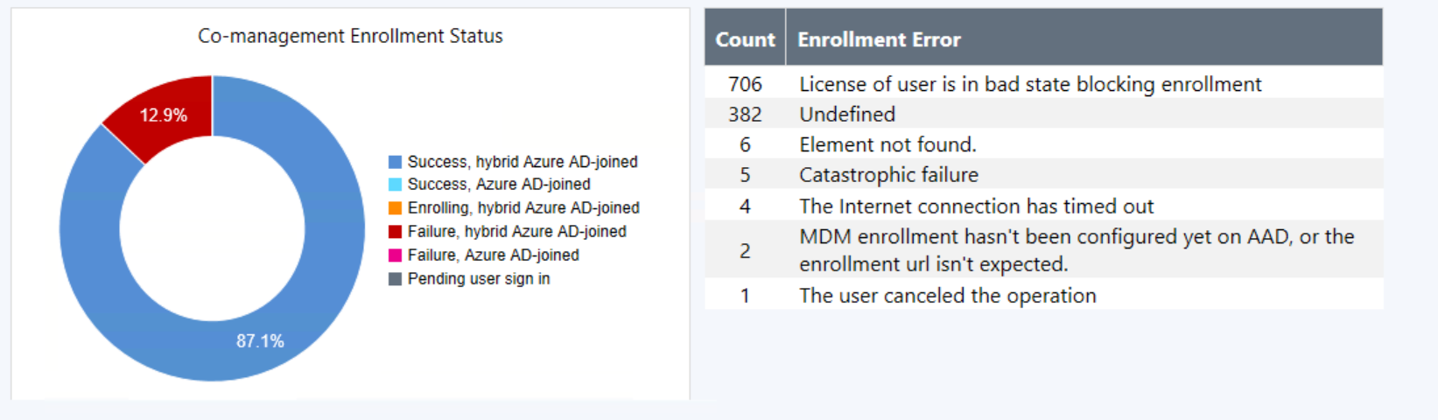
Co-Management Enrollment Status

Slide 31
Co-Managed device enrollment
Co-managed devices will always try to enroll using a Device token
If it fails it will try using the user token, depending on MFA settings this can fail as well.
Important: the default enrollment restriction policy “All Users” is applied to “All Devices“

Slide 32
Troubleshooting Policies
Notes:
Ronni

Slide 33

Device Settings in Microsoft Intune
Recommended order for Windows devices
Endpoint Security
Settings Catalog (Preview)
Templates
Configuration Policies
Built-In Administrative Templates
OMA-URI (Custom CSP)
Custom ADMX ingestion (3rd. Party apps)
PowerShell Scripts
Optional:
Proactive Remediation (Requires a Windows Enterprise E3 license)

Slide 34
Profile Tattooing
Removing the assignment of the profile does not always revert the setting.
The behavior depends on the CSP.
Some setting remains until configured to a different value
Some CSPs remove the setting, and some CSPs keep the setting.
Profiles applies to a User Group and a user is removed from the group.
Note: It can take up to 7 hours + the platform-specific policy refresh cycle.
Wi-Fi, VPN, Certificate, and Email Profiles
These profiles are removed from all supported enrolled devices
Notes:
Some CSPs remove the setting, and some CSPs keep the setting.
There is no documentation on what policies

Slide 35
Policy and Profile refresh cycles
Existing Devices
Windows 10/11 devices will schedule check-in with the Intune service, which is estimated at: About every 8 hours
Recently Enrolled Devices
#1 - Every 3 minutes for 15 minutes
#2 - Every 15 minutes for 2 hours
#3 - Every 8 hours
Manual refresh
Open the Company Portal app and sync the device to immediately check for policy or profile updates.
This device check-in will not refresh the already applied Policy CSP settings.
Trigger Task Scheduler (Recommended for troubleshooting)
Scripted methods

Slide 36
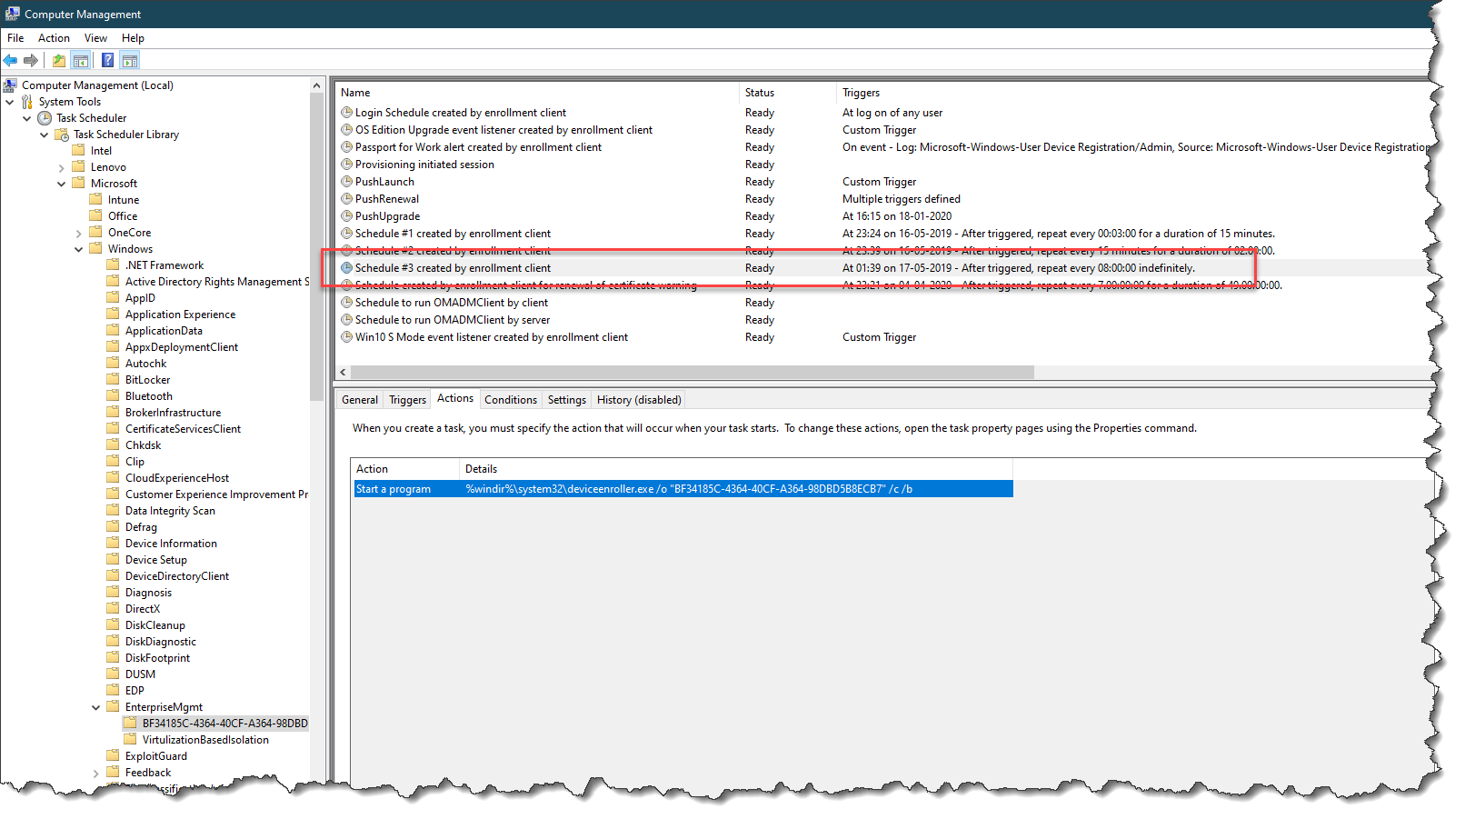

Slide 37

Intune notifications / Sync immediately
Some actions will trigger a sync notification to the device
When a Policy, Profile, or App is:
Assigned (or unassigned)
Updated
Deleted
Current Limitation:
Only the first “XXX” devices will be updated !
By design (to avoid denial of service)
Not the same for all platforms
Workaround: Use script to connect to all clients and force a sync
Notes:
Intune notifications / Sync immediately
DEMO: Show PowerShell Script (APENTO)

Slide 38

Policy/Profile Conflicts
Compliance policy settings always have precedence over configuration profile settings.
Compliance policy conflicts: The most restrictive compliance policy setting applies.
Configuration Profile Conflicts: Shown in Intune.
Manually resolve these conflicts

Slide 39
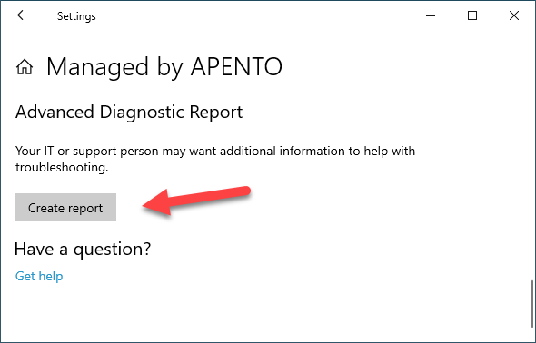
Troubleshooting MDM Policies
C:\Users\Public\Documents\MDMDiagnostics\MDMDiagReport.html
Notes:
DEMO: Show “Windows 11 Start pins” policy

Slide 40
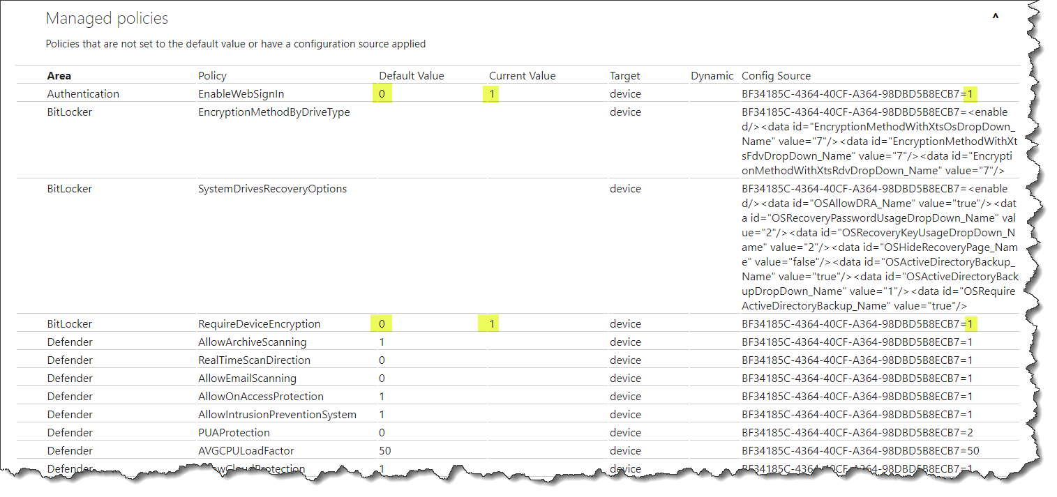
Notes:
Demo:
ConfigureChatIcon
ConfigureStartPins

Slide 41
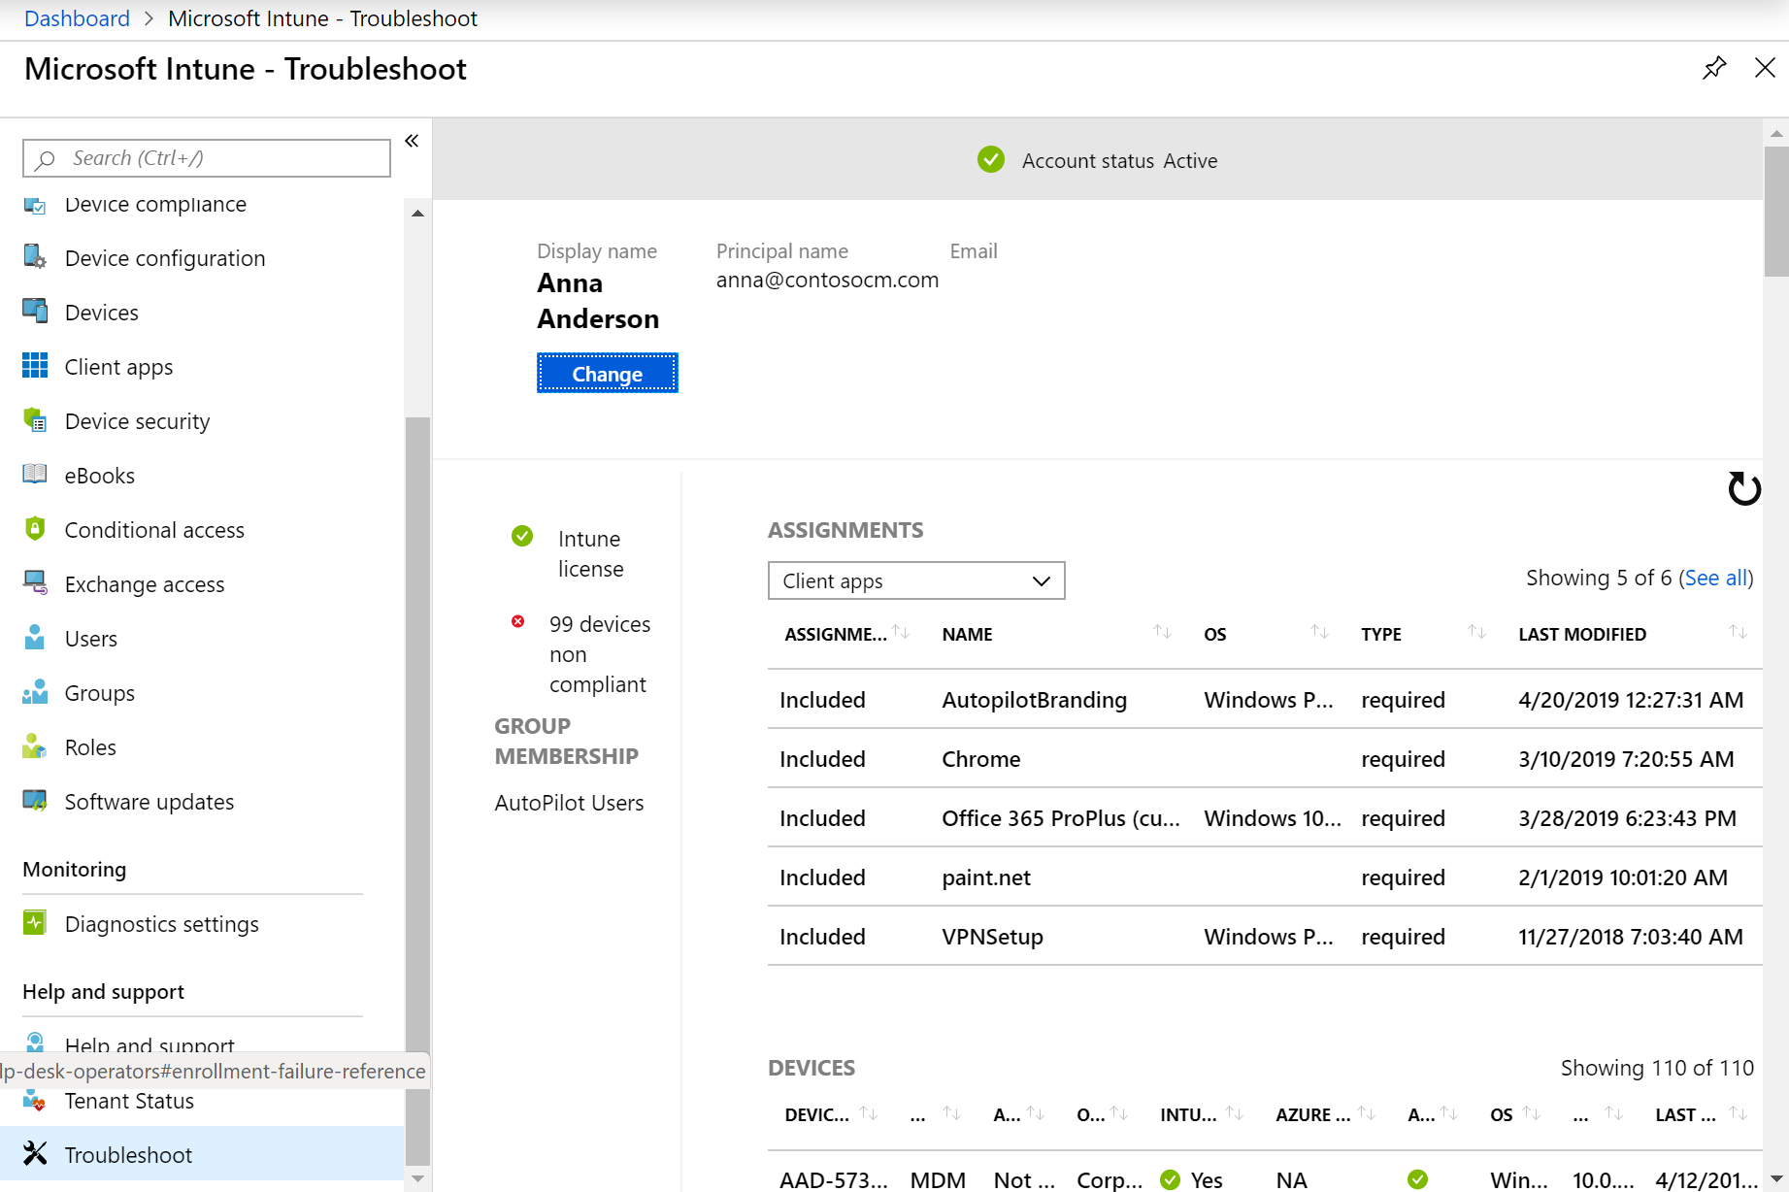
Intune Troubleshooting Pane
Intune portal page
https://aka.ms/intunetroubleshooting
Displays information focused around a particular user
See info about assignments, devices, enrollment failures, etc.
For more info: https://docs.microsoft.com/en-us/intune/help-desk-operators

Slide 42
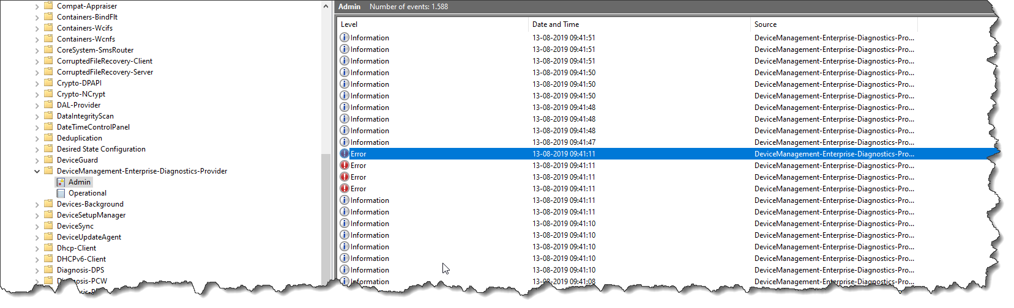
Device Profiles - Where is my logs?
Event viewer is your new best friend
Microsoft-Windows-DeviceManagement-Enterprise-Diagnostics-Provider

Slide 43
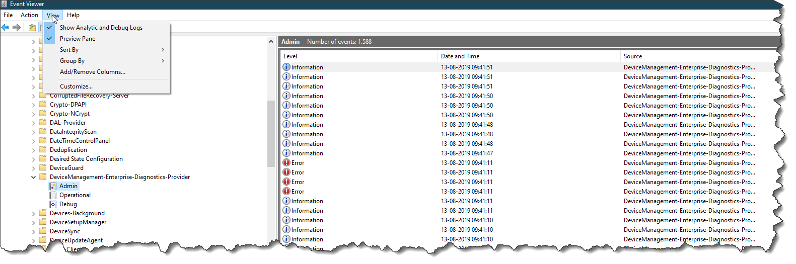
Enable debug mode
Notes:
Many of the things we do is done by the Management Extension

Slide 44
Intune Management Extension
Notes:
Jorgen

Slide 45
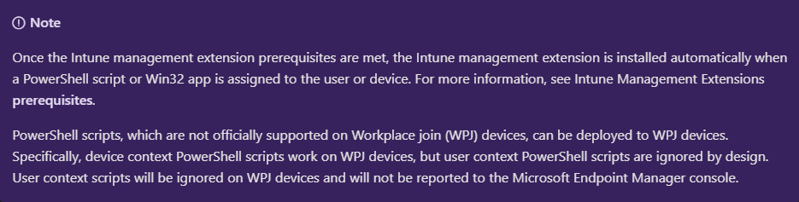
Intune Management Extension Pre-requisites
Installed when first needed by Win32App or PowerShell script.
Installed only on “Corporate” and “personal” devices (personal device context only, added in late 2020-but not supported?!…)
https://docs.microsoft.com/en-us/intune/apps/intune-management-extension#prerequisites
Notes:
Proactive Remediation = IME
Installeret nu = Personal Devices (det sidste år). Men ikke supporteret

Slide 46

What is a Corporate Device?
The enrolling user is using a device enrollment manager account.
The device enrolls through Windows Autopilot.
The device enrolls through a bulk provisioning package.
The device enrolls through GPO
or automatic enrollment from SCCM for co-management.

Slide 47
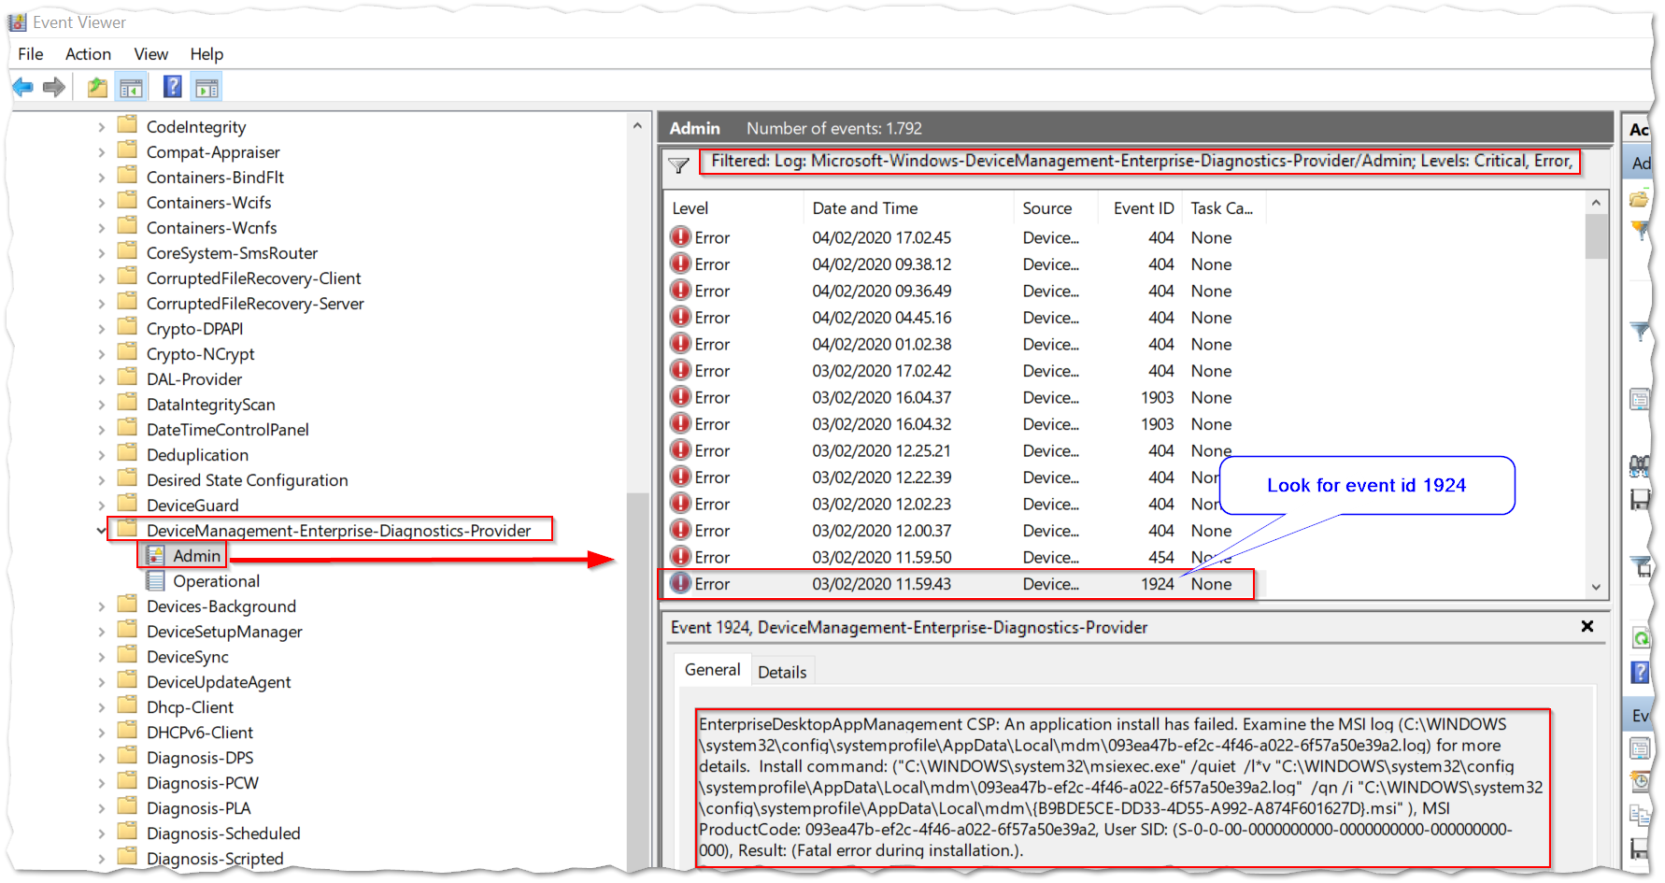
Intune Management Extension Event log
Applications and services logs\Microsoft\Windows\DeviceManage…
Notes:
IME bliver installeret automatisk, men den har også sin egen log

Slide 48
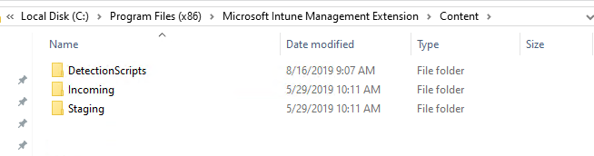
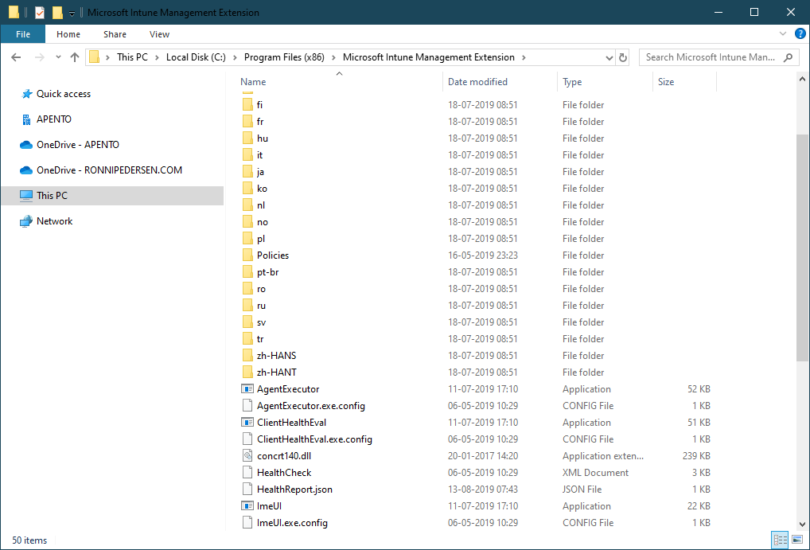
Intune Management Extension File System

Slide 49
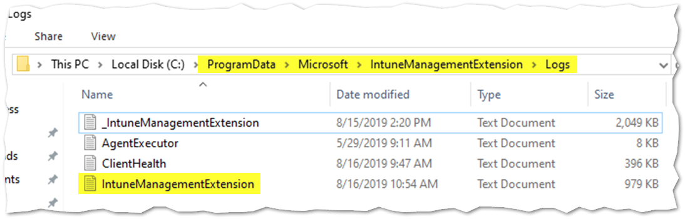
Intune Management Extension Log files
Log files: "C:\ProgramData\Microsoft\IntuneManagementExtension\logs"
Notes:
Har også en lg…

Slide 50
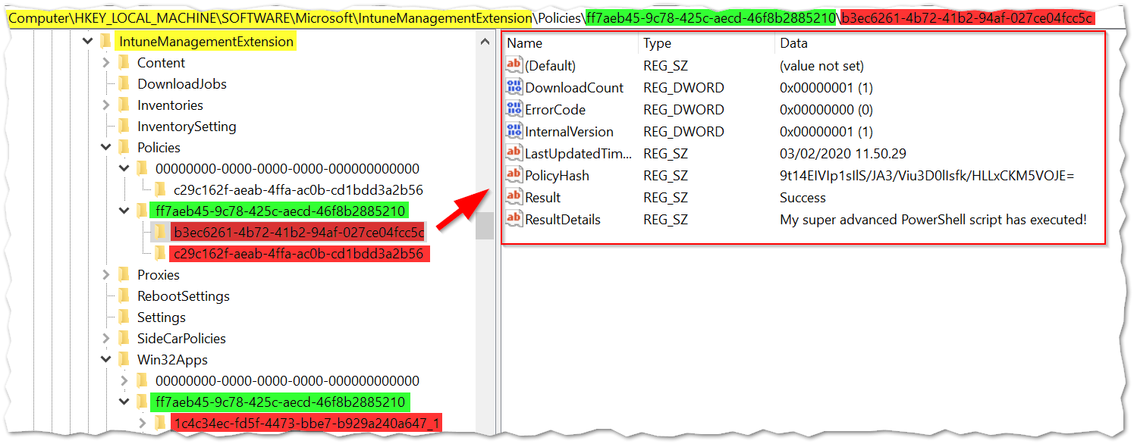
Intune Management Extension The Registry
Yellow: IME Root Registry Key
Green: Azure AD Object ID of the User
Red: Application / Policy GUID

Slide 51
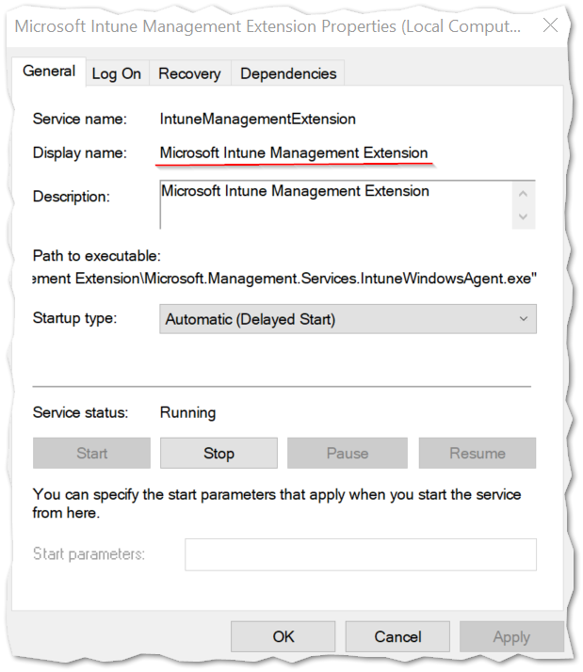
Intune Management Extension
Troubleshooting
Check that the service is installed and running
Verify deployment in MDMDiagReport.html
Are you meeting the Prerequisites?
https://docs.microsoft.com/en-us/intune/apps/ intune-management-extension#prerequisites

Slide 52
Questions ?

